Slide 1

Lecture 1 and 2
Basic Concepts
Computer Organization and Assembly Language

Slide 2

Lecturer
CS2032– Computer Organization and Assembly Language
Khawaja Ubaid ur Rehman
Computer Science Department
Lecturer: UMT Lahore
Email: ubaid.rehman@umt.edu.pk
MS in Software Engineering
Notes:
2

Slide 3
Instructor’s Background
Educational Background and Achievements
  MS-Software Engineering (MS-SE), UMT Lahore
  BS-Computer Science (BS-CS), UMT Lahore
    Awarded three times Dean’s Merit Award
    Awarded Rector’s Medal Award at 11th Convocation of UMT Lahore from Prof. Ahsan Iqbal and honorable Rector Dr. Hasan Sohaib Murad
    Awarded Silver Medal Award at 11th Convocation of UMT Lahore by honorable Rector Dr. Hasan Sohaib Murad
    Awarded Dr. Abdul Qadeer Khan award of Entrepreneurship and Innovation from US General Consul Lahore Zachary Harkenrider and honorable Rector UMT Lahore Dr. Hasan Sohaib Murad in recognition of my publication in international conference IVCNZ IEEE endorsed at 11th Convocation of UMT Lahore.
    Red Hat Certified Network Administrator
Notes:
3

Slide 4
Instructor’s Background
Recent Publications:
  A comparative analysis of Distributed and Parallel Computing in VFAST Journal of SE
  A comparative analysis of Traditional and Cloud Data Warehouse in VFAST Journal of CS
  Algorithms for Data cleaning in Knowledge bases in VFAST Journal of SE
  A Scale and Rotation Invariant Urdu Nastalique Ligature Recognition using Cascade Forward Back propagation Neural Network (IEEE Access Journal)

Slide 5

Students
Answer these questions (Not graded!)
  Your name and city?
  Your favorite subject which you have studied so far?
  Your favorite teacher from which you have studied?
  Total Marks in F.SC/ICS (optional)?

Slide 6
Course Page
  Moodle (http://lms.umt.edu.pk/)
    Search course (Computer Organization and Assembly Language or Khawaja Ubaid ur Rehman)
    SST - School of Systems and Technology - Undergraduate courses – Fall 2024
    All the announcements related to quiz, assignments, Mid and final term etc. will be on Moodle.

Slide 7

Textbook
Textbook
  Assembly Language Programming and Organization Of The IBM Pc by Yatha Yu.
Reference books
  The Intel Microprocessors by Barry b. Brey
  Assembly Language for Intel-Based Computer by Kip R.Irvin

Slide 8

Grading Policy(tentative)
Instrument | Description | Weight
Assignments | Assigned during important stages of the course to apply and practice the learnt concepts | 10%
Quizzes | In-class (un)announced or may be announced quizzes 15 to 20 minutes tests | 20%
Mid-Term Exam | A single 75-minute exam from the material covered during the first 6-7 weeks | 30%
Final Exam | Will cover the entire course. At least 90% of the topics would be from post mid term. | 40%
Late Submission Policy: Late submissions not allowed

Slide 9
Classroom Policy
Maintain teacher and student respect decorum.
Behavior is very important. Be obedient.
Attendance is very important, 85% is required, 100% is recommended. Be regular and be punctual.
Do not come late in the class. Late comers attendance will not be marked as online attendance is closed.
Avoid to use mobile phones during lecture. Keep your mobiles switch off or in silent mode.
It is your responsibility not to delete your assignment on Moodle even after its submission.
Quizzes can be announced or unannounced. 1 quiz can be dropped out of 5 or 6 quizzes. No retake for missed quizzes.
*The plagiarism(copy/paste) and cheating cases would be reported to the Disciplinary Committee.
*Only 6 absentees are allowed in any course. On 7th absentee you will be marked Short Attendance (SA).
Moodle will be the resource sharing medium, keep checking the Moodle page and your emails regularly.

Slide 10
Goals and Required Background
Goals: broaden student’s interest and knowledge in …
  Basic organization of a computer system
  Intel IA-16 and IA-32 processor architecture
  How to write assembly language programs
  How high-level languages translate into assembly language
  Interaction between the assembly language programs, libraries, the operating system, and the hardware
  How interrupts, system calls, and handlers work
Required Background
  The student should already be able to program confidently in at least one high-level programming language, such as Java or C.

Slide 11
Computer Circuit Parts
Functionally Computer Circuit consists of three parts:
  Central Processing Unit (CPU)
  Memory
  I/O devices
In a microcomputer CPU is a single chip processor called microprocessor.
CPU is a brain of computer it controls all the operations.
It uses memory circuits to store information and I/O circuits to communicate with I/O devices.

Slide 12
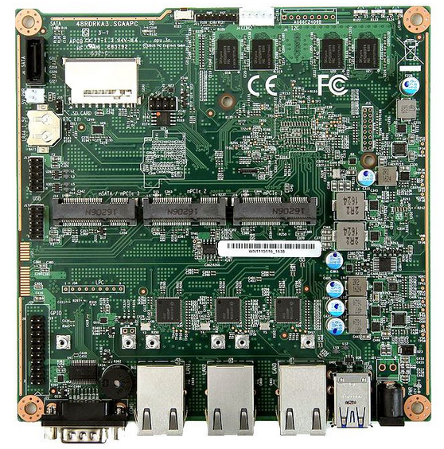
System board
Inside the system unit is a main circuit board called system board, which contains the microprocessor and memory circuits. The system board is also called a motherboard.

Slide 13
Memory
There are two kinds of memory
  RAM it a volatile memory which loses its contents when computer is turned off.
  ROM it a non-volatile memory which does not loses its contents when the computer is turned off.

Slide 14
Overview of RAM
RAM stands for Random Access Memory. It is also called direct access memory.
RAM is used to store data and instructions temporarily.
A program must be loaded into RAM before execution.
RAM is a volatile memory. It means that its contents are lost when the power is turned off.
RAM is read/write memory.
CPU can read from data from RAM and write data to RAM
It is used to store data and instructions while it is being executed.
RAM is also called main memory or primary storage.

Slide 15
Overview of ROM
ROM stands for Read Only Memory. The instructions in ROM prepare the computer for use. These instructions can be read but cannot be changed or deleted.
It is not possible to write new information or instructions into the ROM.
ROM stores data and instructions permanently. When the power is switched off the instructions stored in ROM are not lost. Therefore, ROM is called non volatile memory.
The information in ROM is stored by the manufacturer. When the computer is switched on, the instructions in the ROM are automatically loaded into the memory of the computer. The ROM based programs are known as firmware. They are responsible for loading start up programs as well as for self testing of computer when it is turned on.

Slide 16
Cache Memory
A cache is a small and very fast memory. It is designed to speed up the transfer of data and instructions.
It is located close to CPU chip. It is more expensive and faster than RAM.
The data and instructions that are most recently or frequently used the CPU are stored in cache.
The data and instructions are retrieved from RAM when CPU uses them for the first time. A copy of data or instructions is stored in cache. The next time the CPU needs that data or instruction, it looks in cache. If the required data is found there it is retrieved from cache memory instead of main memory. It speeds up the working of CPU.

Slide 17
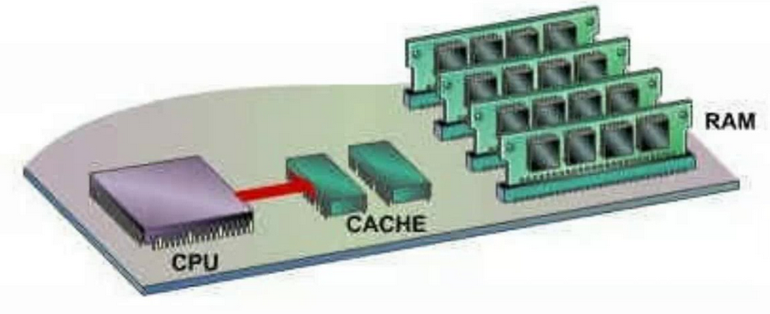
Cache Memory

Slide 18
Byte and Words
Information processed by the computer is stored in its memory.
A memory circuit element can store one bit of data.
However, the memory circuits are usually organized into groups that can store eight bits of data
A string of eight bits is called as byte.
Each memory byte or memory circuit is identified by a number that is called its address.

Slide 19
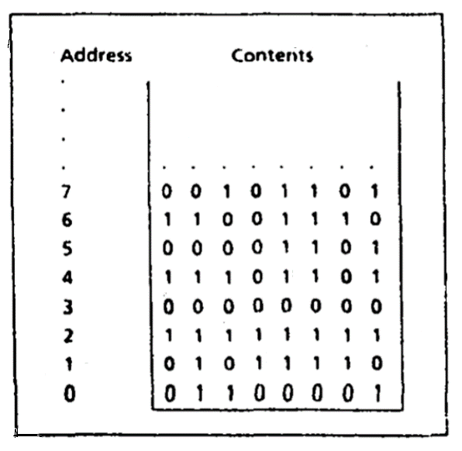
Address and Contents
The first memory byte has address 0.
The data stored in memory byte are called its contents.

Slide 20
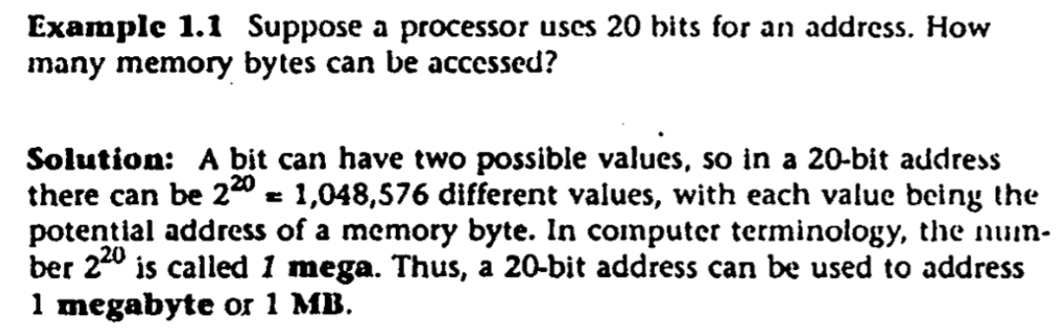
Difference between Address and Contents
Address | Contents
Address of memory byte is fixed. It is different from the address of any other memory byte in memory | The contents of memory byte are not unique. They are subject to change because they denote the data currently being stored.
The number of bits in an address depends on processor. | Contents of a memory byte are always eight bits

Slide 21
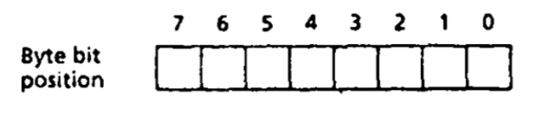
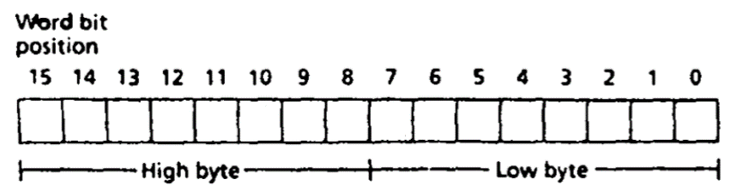
Byte and Word
In a typical microcomputer, two bytes form a word. As we know that 1 byte = 8 bits, So, 2 byte = 16 bits

Slide 22
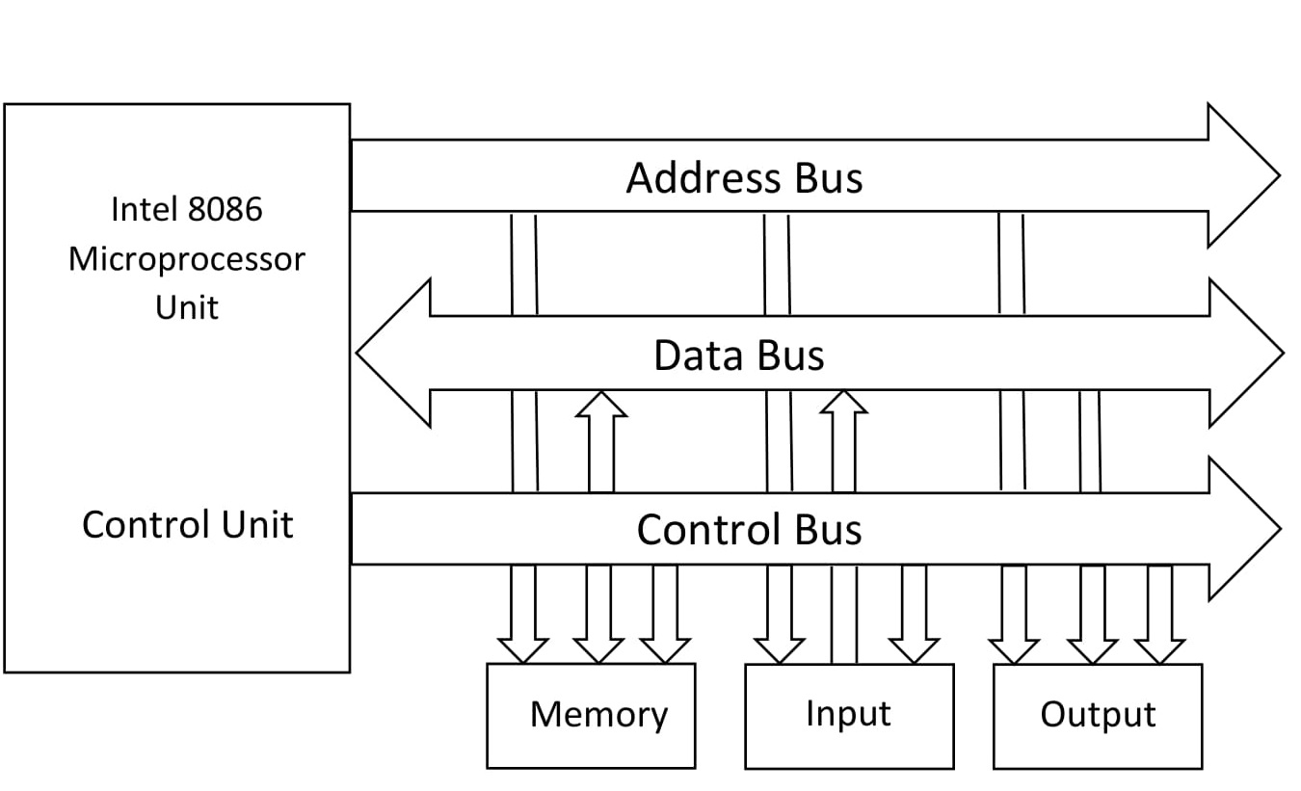
Buses
A processor communicates with memory and l/O devices by using signals that travel along a set of wires or connections called buses.
These buses connect different components of computer. There are three kinds of buses:
  Data bus
  Address bus
  Control bus

Slide 23
Address, Data and Control Bus
To inform memory whether processor wants to read or write – control bus
To inform memory the precise element processor is interested in – address bus
To transfer the data element from memory to processor – data bus

Slide 24
Basic Computer Organization
Since the 1940's, computers have 3 classic components:
  Processor, called also the CPU (Central Processing Unit)
  Memory and Storage Devices
  I/O Devices
Interconnected with one or more buses
Bus consists of
  Data Bus
  Address Bus
  Control Bus

Slide 25
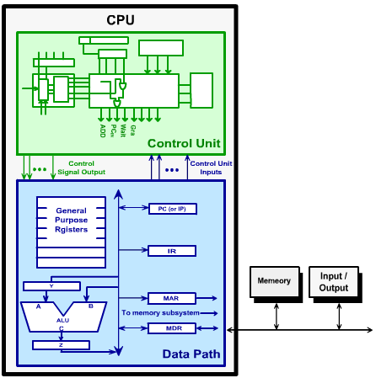
Processor (CPU)
Processor consists of
  Datapath
    ALU
    Registers
  Control unit
ALU
  Performs arithmetic
  and logic instructions
Control unit (CU)
  Generates the control signals required to execute instructions
Implementation varies from one processor to another

Slide 26
What is Assembly Language?
Assembly language is a low level language.
Assembly language is based on mnemonics. Mnemonics are basically English like keywords.
  For example,
    Add
    Sub
    Inc
    Dec
    loop
    Mul
    Div
    Many more…
Notes:
26

Slide 27
What is Assembly Language?
Assembly language is not case sensitive.
Default extension of assembly code is .asm
Assembly language code is translated into machine language via assembler.
  What is Assembler?
    An assembler is program which translates assembly language code into machine code.
      For Example, MASM, TASM, NASM etc.
Assembly language has one to one correspondence with machine language.

Slide 28
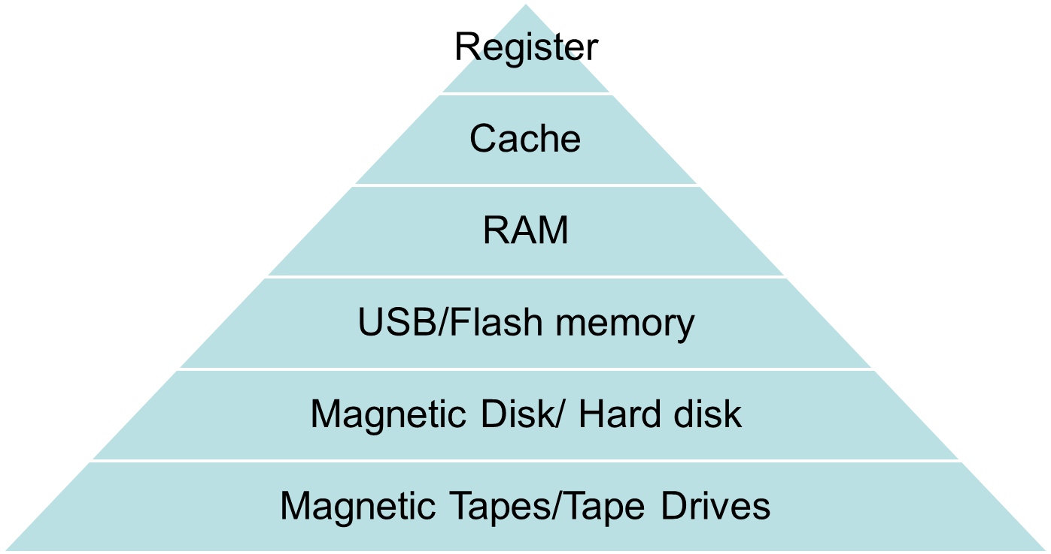






Memory Hierarchy
AT
Cost decrease
bytes
Internal Memory
Speed decrease
Kb to MB
Size increase
GB
Primary Memory
GB
Secondary Memory
TB
PB to EB
Tertiary Memory

Slide 29
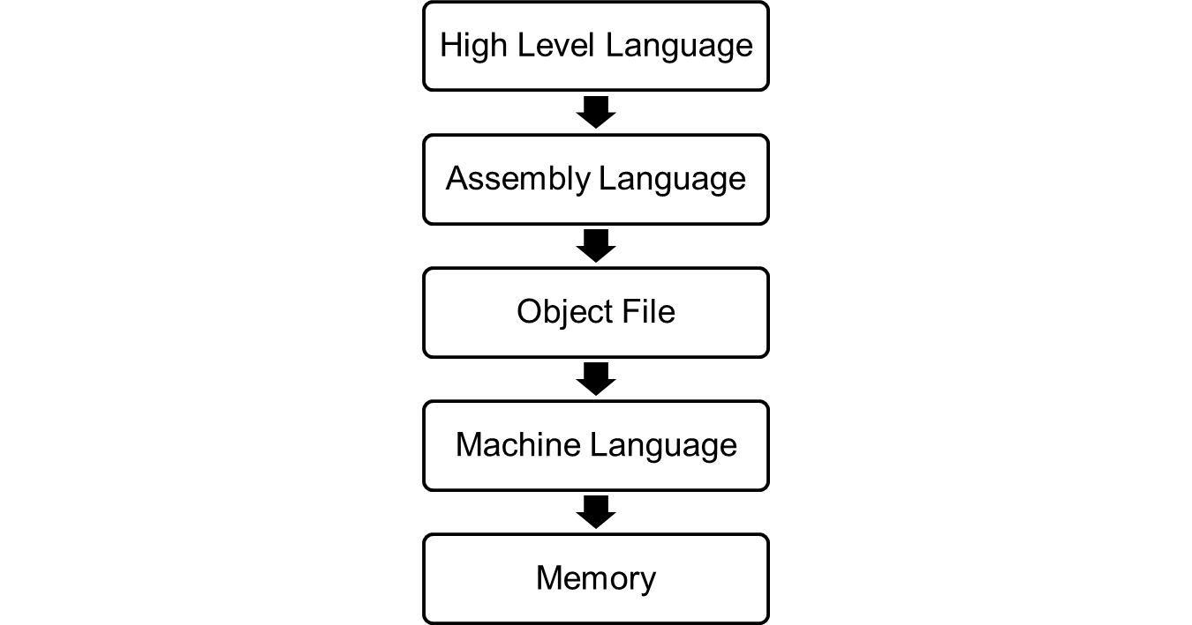
Code conversion process
First.cpp
Compiler
First.asm
Assembler
First.obj
Linker
First.exe
Loader

Slide 30
Why we need to study Assembly language?
How the processor interacts with OS, hardware.
How the processor access and executes instruction.
How the program access external devices.
It requires less memory and execution time.
Better/deep understanding of software and hardware
Optimization of processing time
We can access and use registers using this language.
The executable code of high-level language is larger than assembly language code so it takes a longer time to execute.
Due to long executable code, high-level programs are less space efficient than assembly language programs.

